Slide 1
PerfTest: Implementation
Yoonki Song
Last Updated: 10/2/2009

Slide 2
TPTP
Prerequisites

Slide 3
TPTP Source Code
Plugin: /org.eclipse.hyades.trace.ui
Class name: org.eclipse.hyades.trace.internal.ui.PDProjectExplorer (“Profiling Monitor” viewpart)
Plugin: /org.eclipse.hyades.trace.ui
Class name: org.eclipse.hyades.trace.ui.internal.wizard. ImportTracePage1 (“Profiling File” wizard page)

Slide 4
org.eclipse.hyades.models.hierarchy
org.eclipse.hyades.loaders.util.XMLLoader
org.xml.sax.SAXParseException
import javax.xml.parsers.ParserConfigurationException;
import javax.xml.parsers.SAXParser;
import javax.xml.parsers.SAXParserFactory;
import org.eclipse.hyades.models.hierarchy.util.ModelDebugger;
import org.xml.sax.Attributes;
import org.xml.sax.InputSource;
import org.xml.sax.Locator;
import org.xml.sax.SAXException;
import org.xml.sax.SAXParseException;
import org.xml.sax.helpers.DefaultHandler;

Slide 5
References
TPTP CVS Repository
:pserver:anonymous@dev.eclipse.org:/cvsroot/tptp

Slide 6
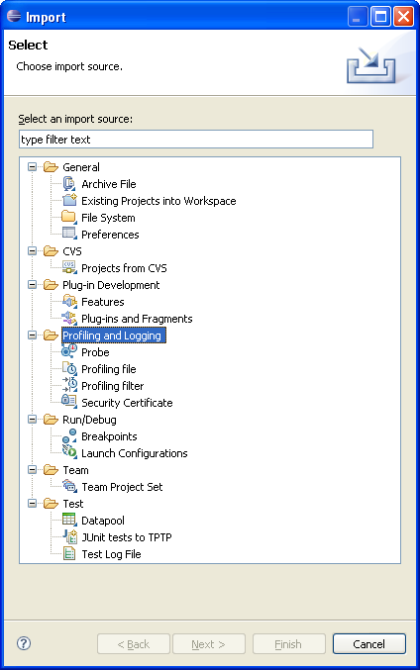

Slide 7
Comparing Trace data from RPT and TPTP

Slide 8
Start the Plant web application (AppSrv02, 9083, 9063)
Setup the environment for RPT profiling
Create a performance test suite for the Plant web application.
Run the performance test suite by RPT while collecting profiling data by RPT. The profiling data is stored in a local trcxml file (t1_rpt.trcxml)
Restart the Plant web application (after uninstrumentation)
Setup the environment for TPTP profiling
Run the performance test suite by RPT while collecting profiling data by TPTP. The profiling data is stored in a local trcxml file (t1_tptp.trcxml)
Compare t1_rpt.trcxml and t1_tptp.trcxml to figure out the difference.

